Slide 1

Elementary Programming
Learn how to create, compile and run very basic Java programs.
Elementary programming using primitive data types, variables, constants, operators, expressions and input and output.
Also learn the basic steps that goes into analyzing a problem,

Slide 2
Writing a Simple Program
Problem of computing the area of the circle:
Storing the radius in the program.
public class ComputeArea {
public static void main(String[ ] args) {
double radius;
double area;
radius = 20;
area = radius * radius * 3.14159;
System.out.println("The area of the circle of radius " + radius + " is " + area);
}
}

Slide 3
Writing a Simple Program
Problem of computing the area of the circle:
Reading the radius using Scanner class object.
import java.util.Scanner;
public class ComputeArea {
public static void main(String[ ] args) {
Scanner input = new Scanner(System.in);
double radius = input.nextDouble();
double area = radius * radius * 3.14159;
System.out.println("The area of the circle of radius " + radius + " is " + area);
}
}

Slide 4
Identifiers
Identifiers are the names that identify the elements such as classes, methods, and variables in a program.
An identifier is a sequence of characters that consist of letters, digits, underscores (_), and dollar signs ($).
An identifier must start with a letter, an underscore (_), or a dollar sign ($). It cannot start with a digit.
An identifier cannot be a reserved word.
An identifier cannot be true, false, or null.
An identifier can be of any length.

Slide 5
Identifiers
Which of the following identifiers are valid? Which are Java keywords?
miles, Test, a++, – – a, 4#R, $4, #44, apps class, public, int, x, y, radius

Slide 6
Variables
They are called variables because their values can be changed.
// Compute the first area
radius = 1.0;
area = radius * radius * 3.14159;
System.out.println("The area is “ + area + " for radius "+radius);
// Compute the second area
radius = 2.0;
area = radius * radius * 3.14159;
System.out.println("The area is “ + area + " for radius "+radius);

Slide 7
Variables
Variables are used to represent values that may be changed in the program.
Variable declaration tells the compiler to allocate appropriate memory space for the variable based on its data type.
The syntax for declaring a variable is
datatype variableName;
Examples:
int x; // Declare x to be an
// integer variable;
double radius; // Declare radius to
// be a double variable;
char a; // Declare a to be a
// character variable;

Slide 8
Variables
If variables are of the same type, they can be declared together, as follows:
datatype variable1, variable2, ..., variablen;
Example:
int i, j, k; // Declare i, j, and k as int variables
Variables often have initial values. You can declare a variable and initialize it in one step.
Example:
int count = 1;
This is equivalent to the next two statements:
int count;
count = 1;
We can also use a shorthand form to declare and initialize variables of the same type together.
Example:
int i = 1, j = 2;

Slide 9
Variables
Identify and fix the errors in the following code:
public class Test {
public static void main(String[] args) {
int i = k + 2;
System.out.println(i);
}
}

Slide 10
Assignment Statements and Assignment Expressions
An assignment statement designates a value for a variable.
An assignment statement can be used as an expression in Java.
Syntax:
variable = expression;
An expression represents a computation involving values, variables, and operators that, taking them together, evaluates to a value.
Example:
int y = 1; // Assign 1 to variable y
double radius = 1.0; // Assign 1.0 to variable radius
int x = 5 * (3 / 2); // Assign the value of the expression to x
x = y + 1; // Assign the addition of y and 1 to x
double area = radius * radius * 3.14159; // Compute area
You can use a variable in an expression. A variable can also be used in both sides of the = operator.
Example:
x = x + 1;

Slide 11
Assignment Statements and Assignment Expressions
In Java, an assignment statement is essentially an expression that evaluates to the value to be assigned to the variable on the left side of the assignment operator.
For this reason, an assignment statement is also known as an assignment expression.
Below statement is correct:
System.out.println(x = 1);
Which is equivalent to
x = 1;
System.out.println(x);

Slide 12
Assignment Statements and Assignment Expressions
If a value is assigned to multiple variables, you can use this syntax:
i = j = k = 1;
Which is equivalent to
k = 1;
j = k;
i = j;

Slide 13
Assignment Statements and Assignment Expressions
Identify and fix the errors in the following code:
public class Test {
public static void main(String[] args) {
int i = j = k = 2;
System.out.println(i + "" + j + "" + k);
}
}

Slide 14
Named Constants
A named constant is an identifier that represents a permanent value.
A constant must be declared and initialized in the same statement.
Syntax:
final datatype CONSTANTNAME = value;
Example:
final double PI = 3.14159;

Slide 15
Named Constants
Benefits of using constants:
You don’t have to repeatedly type the same value if it is used multiple times;
If you have to change the constant value (e.g., from 3.14 to 3.14159 for PI), you need to change it only in a single location in the source code;
A descriptive name for a constant makes the program easy to read.

Slide 16
Naming Conventions
Sticking with the Java naming conventions makes your programs easy to read and avoids errors.
Choose descriptive names with straightforward meanings for the variables, constants, classes, and methods in your program.
Conventions for naming variables, methods and classes:
Use lowercase for variables and methods.
If a name consists of several words, concatenate them into one, making the first word lowercase and capitalizing the first letter of each subsequent word — for example, the variables radius and area and the method print.
Capitalize the first letter of each word in a class name — for example, the class names ComputeArea and System.
Capitalize every letter in a constant, and use underscores between words — for example, the constants PI and MAX_VALUE.

Slide 17
Numeric Data Types and Operations
Java has six numeric types for integers and floating-point numbers with operators +, –, *, /, and %.

Slide 18
Reading Numbers from the Keyboard
Scanner input = new Scanner(System.in);
int value = input.nextInt();

Slide 19
Numeric Operators

Slide 20
Naming Conventions
Remainder is very useful in programming.
Suppose today is Saturday and you and your friends are going to meet in 10 days. What day is in 10 days?
You can find that day using the following expression:
(6 + 10) % 7 = 2
Day 6 in a week is Saturday
A week has 7 days
Meeting after 10 days
Day 2 in a week is Tuesday

Slide 21
Exponent Operations
Math.pow(a, b) method can be used to compute a^{b}.
The pow method is defined in Math class in the Java API.
Syntax:
Math.pow(a, b)
Examples:
System.out.println(Math.pow(2, 3)); // Displays 8.0
System.out.println(Math.pow(4, 0.5)); // Displays 2.0
System.out.println(Math.pow(2.5, 2)); // Displays 6.25
System.out.println(Math.pow(2.5, -2)); // Displays 0.16

Slide 22
Numeric Literals
A literal is a constant value that appears directly in a program.
Example,
34 and 0.305 are literals in the following statements:
int numberOfYears = 34;
double weight = 0.305;

Slide 23
Integer Literals
An integer literal can be assigned to an integer variable if it can fit into the variable.
A compile error will occur if the literal is too large for the variable to hold.
Example:
byte b = 128 , will cause a compile error
An integer literal is assumed to be of the int type, whose value is between – 2³¹ ( -2147483648) and 2³¹ – 1 (2147483647).
To denote an integer literal of the long type, append the letter L or l to it.
Example, to write integer 2147483648 in a Java program, you must write it as 2147483648L or 2147483648l.

Slide 24
Floating-Point Literals
Floating-point literals are written with a decimal point. By default, a floating-point literal is treated as a double type value.
Example:
5.0 is considered a double value, not a float value.
You can make a number a float by appending the letter f or F, and you can make a number a double by appending the letter d or D.
Example:
100.2f or 100.2F for a float number, and 100.2d or 100.2D for a double number.

Slide 25
Float Vs. Double
The double type values are more accurate than the float type values.
Example,
System.out.println("1.0 / 3.0 is " + 1.0 / 3.0);
displays 1.0 / 3.0 is 0.3333333333333333
16 digits
System.out.println("1.0F / 3.0F is " + 1.0F / 3.0F);
displays 1.0F / 3.0F is 0.33333334
8 digits
A float value has 7 to 8 number of significant digits and a double value has 15 to 17 number of significant digits.

Slide 26
Scientific Notation
Floating-point literals can be written in scientific notation in the form of a x 10^{b}.
Example, the scientific notation
for 123.456 is 1.23456 x 10² and
for 0.0123456 is 1.23456 x 10⁻²
A special syntax is used to write scientific notation numbers.
Example:
1.23456 x 10² is written as 1.23456E2 or 1.23456E+2 and
1.23456 x 10⁻² as 1.23456E-2.

Slide 27
Numeric Literals
To improve readability, Java allows you to use underscores between two digits in a number literal.
Example, the following literals are correct:
long ssn = 232_45_4519;
long creditCardNumber = 2324_4545_4519_3415L;

Slide 28
Evaluating Expressions and Operator Precedence
is translated to
(3+4*x)/5 – 10*(y-5)*(a+b+c)/x + 9*(4/x + (9+x)/y)

Slide 29
Evaluating Expressions and Operator Precedence
Java has its own way to evaluate an expression behind the scene, the result of a Java expression and its corresponding arithmetic expression is the same.
Operators contained within pairs of parentheses are evaluated first.
Parentheses can be nested, in which case the expression in the inner parentheses is evaluated first.

Slide 30
Evaluating Expressions and Operator Precedence
When more than one operator is used in an expression, the following operator precedence rule is used to determine the order of evaluation.
Multiplication, division, and remainder operators are applied first. If an expression contains several multiplication, division, and remainder operators, they are applied from left to right.
Addition and subtraction operators are applied last. If an expression contains several addition and subtraction operators, they are applied from left to right.

Slide 31
Evaluating Expressions and Operator Precedence
Example:

Slide 32
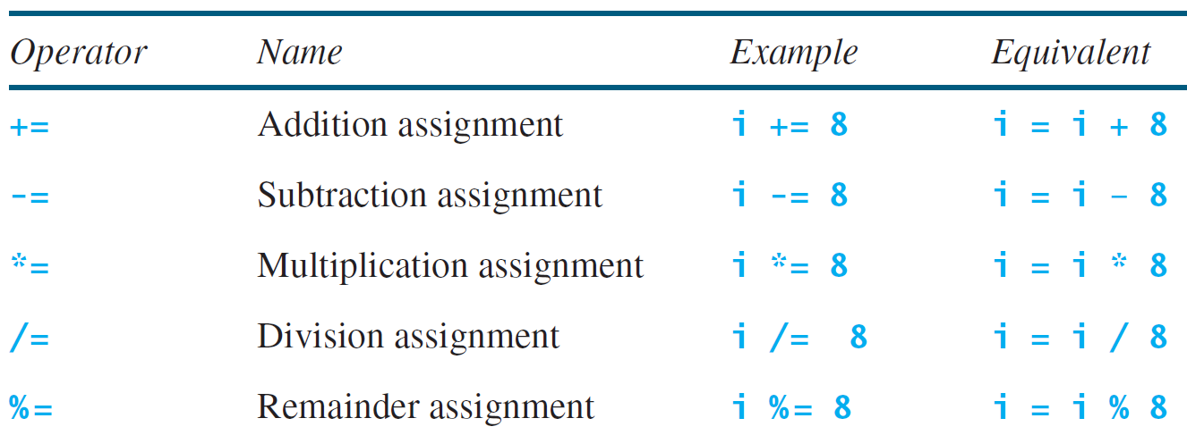
Augmented Assignment Operators

Slide 33
Augmented Assignment Operators
Show the output of the following code:
double a = 6.5;
a += a + 1;

Slide 34
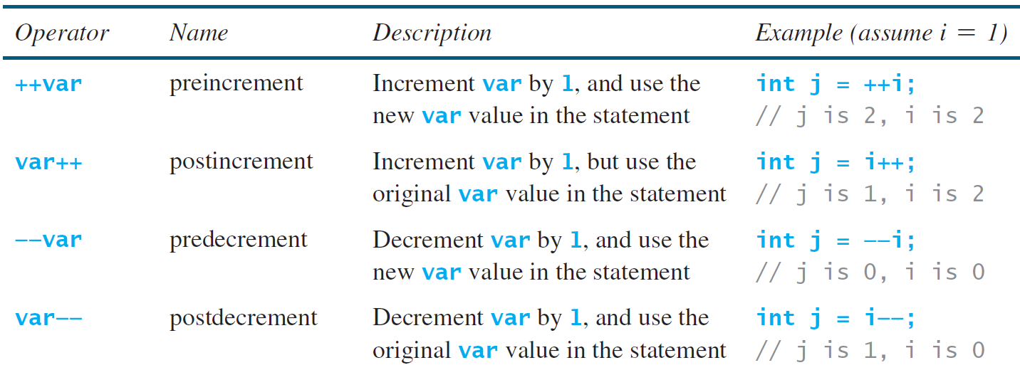
Increment and Decrement Operators

Slide 35
Increment and Decrement Operators

Slide 36
Increment and Decrement Operators
Show the output of the following code:
double x = 1.0;
double y = 5.0;
double z = x–– + (++y);

Slide 37
Increment and Decrement Operators
Using increment and decrement operators makes expressions short, but it also makes them complex and difficult to read.
Avoid using these operators in expressions that modify multiple variables or the same variable multiple times, such as this one:
int k = ++i + i.

Slide 38
Numeric Type Coversions
Can you perform binary operations with two operands of different types?
Yes. If an integer and a floating-point number are involved in a binary operation, Java automatically converts the integer to a floating-point value.
So, 3 * 4.5 is same as 3.0 * 4.5.

Slide 39
Numeric Type Conversions
We can always assign a value to a numeric variable whose type supports a larger range of values; can assign a long value to a float variable.
You cannot, however, assign a value to a variable of a type with a smaller range unless you use type casting.
Casting is an operation that converts a value of one data type into a value of another data type.
Casting a type with a small range to a type with a larger range is known as widening a type.
Casting a type with a large range to a type with a smaller range is known as narrowing a type.
Java will automatically widen a type, but you must narrow a type explicitly.

Slide 40
Numeric Type Conversions
Implicit casting
double d = 3; (type widening)
Explicit casting
int i = (int)3.0; (type narrowing)
int i = (int)3.9; (Fraction part is truncated)

Slide 41
Numeric Type Conversions
Casting does not change the variable being cast.
Example:
double d = 4.5;
int i = (int)d; // i becomes 4, but d is still 4.5

Slide 42
Numeric Type Conversions
Casting is necessary if you are assigning a value to a variable of a smaller type range.
A compile error will occur if casting is not used in this situation.
Example:
double d = 4.5;
int i = d; // leads to compilation error

Slide 43
Numeric Type Conversions
In Java, an augmented expression of the form x1 op= x2 is implemented as x1 = (T)(x1 op x2), where T is the type for x1.
Therefore, the following code is correct.
int sum = 0;
sum += 4.5; // sum becomes 4 after this statement
sum += 4.5 is equivalent to sum = (int)(sum + 4.5).

Slide 44
Any Questions?

